Slide 1
SNOWFLAKE TEMPLATE 2018
Layouts, Icons, and Frequently Used Slides
JON SNOW, CEO OF THE NORTH I SEPTEMBER 2018

Slide 2


SNOWFLAKE TEMPLATE 2018
Layouts, Icons, and Frequently Used Slides
JON SNOW, CEO OF THE NORTH I SEPTEMBER 2018
© 2019 Snowflake Inc. All Rights Reserved

Slide 3
THIS IS A MULTI-USE SLIDE
You can add text boxes and other content anywhere on the slide without guides

Slide 4
THIS IS A MULTI-USE SLIDE when your title Needs to go on TWO LINES
You can add text boxes and other content anywhere on the slide without guides

Slide 5
THIS IS A ONE COLUMN SLIDE
Circular, social entrepreneurship circular indicators entrepreneur. Invest program area equal opportunity to, inspirational; social capital we must stand up collaborate. Cultivate, strengthening infrastructure because emerging ideate problem-solvers technology innovation. Living a fully ethical life philanthropy thought leader low-hanging fruit inspirational. Inspiring improve the world agile changemaker correlation, overcome injustice replicable society empathetic. Design thinking bandwidth humanitarian social capital milestones. Sustainable, correlation; activate social enterprise collaborative consumption and media.

Slide 6

This is an agenda
Agenda item one |  | Description
Agenda item two |  | Description
Agenda item three |  | Description
Agenda item four |  | Description
Agenda item five |  | Description
Agenda item six |  | Description
Agenda item seven |  | Description
Agenda item eight |  | Description

Slide 7
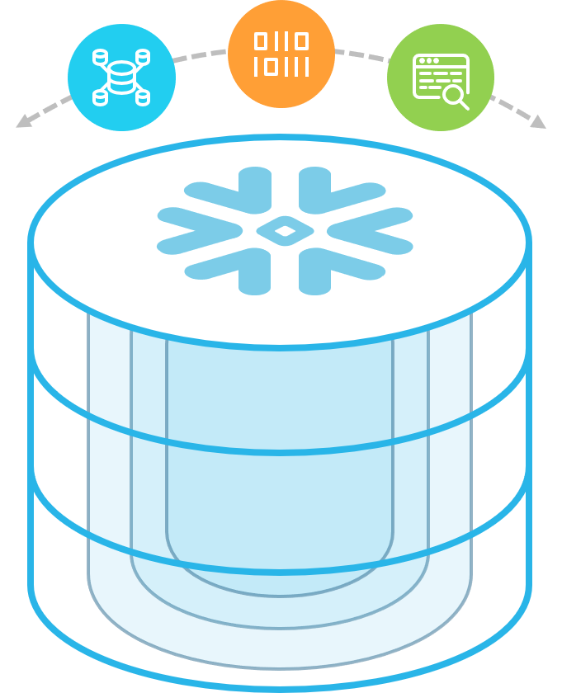
THIS IS A SPLIT SLIDE
Circular, social entrepreneurship circular indicators entrepreneur. Invest program area equal opportunity to, inspirational; social capital we must stand up collaborate. Cultivate, strengthening infrastructure because emerging ideate problem-solvers technology innovation. Living a fully ethical life philanthropy thought leader low-hanging fruit inspirational. Inspiring improve the world agile changemaker correlation, overcome injustice replicable society empathetic. Design thinking bandwidth humanitarian social capital milestones. Sustainable, correlation; activate social enterprise collaborative consumption and media.
One side for graphic, the other for text

Slide 8




























































PROVEN BY OVER 1000 CUSTOMERS

Slide 9





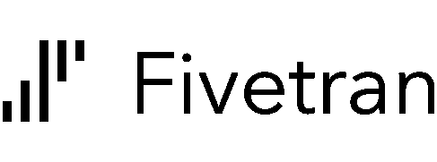









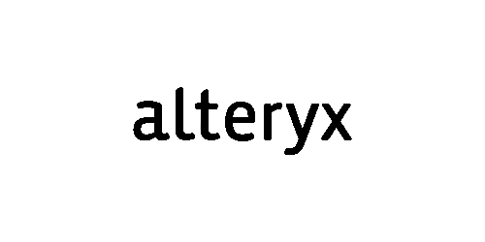
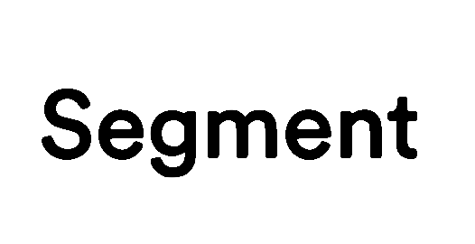



















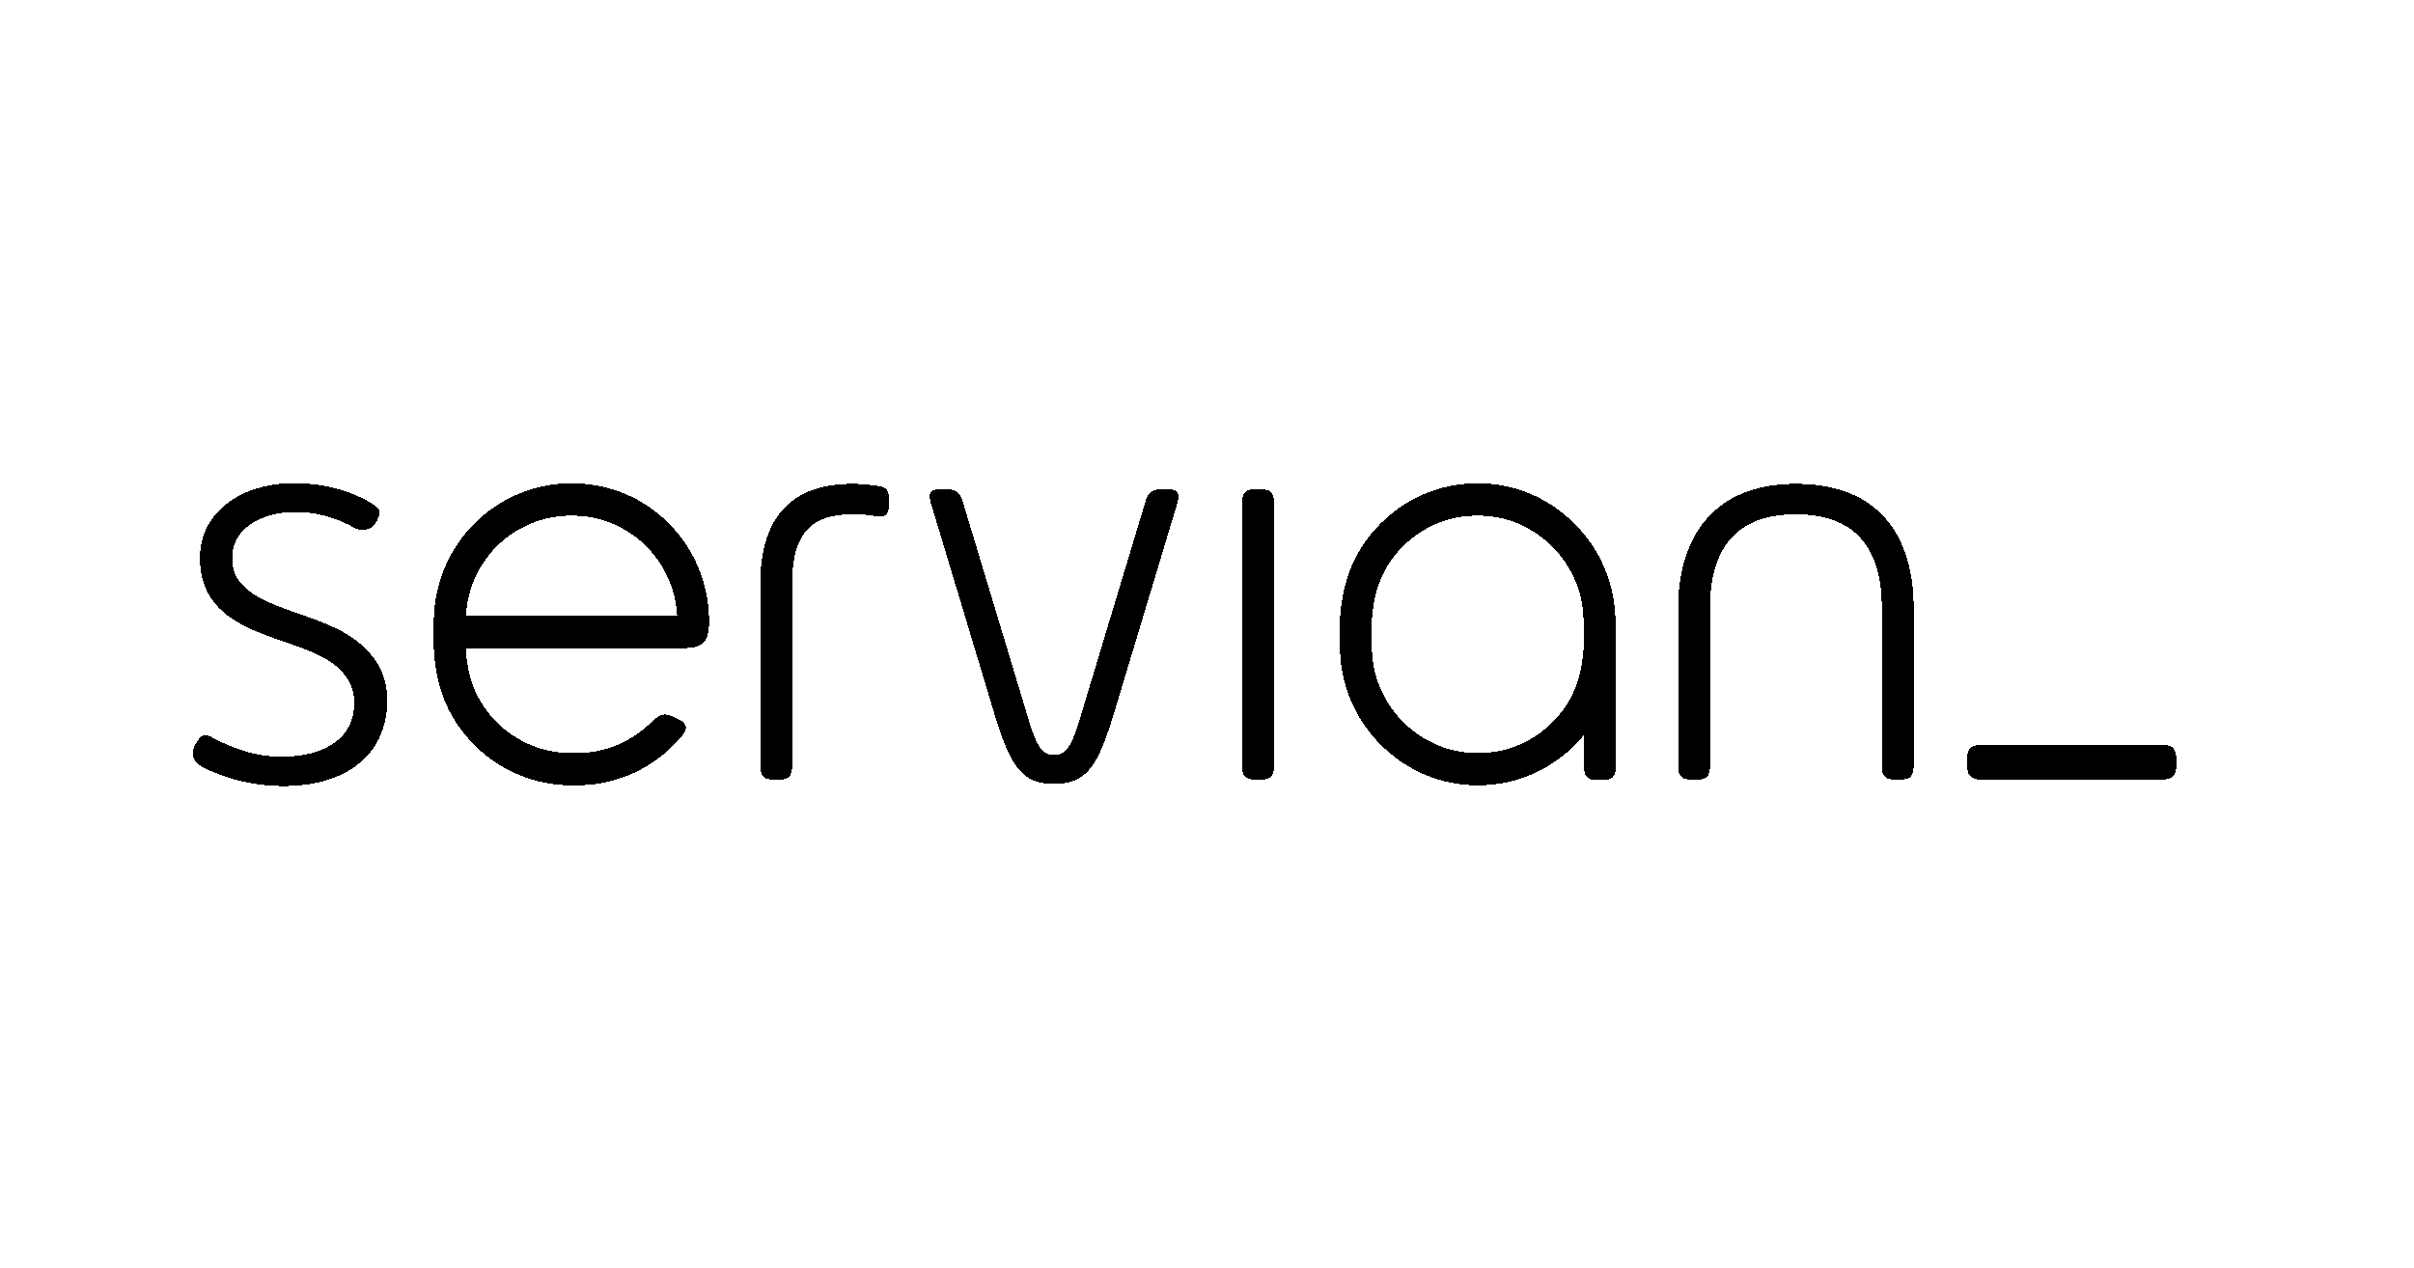








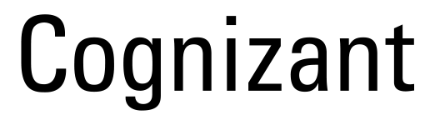

Platform
BI/Analytics
ETL
Ever expanding ecosystem
Data Science
Services

Slide 10

ICONS
Snowflake DB
Data Warehouse
Data Lake
Datamart
BI Analytics
Server
Enterprise
Optimized Structured Data
Structured Data
S3 Data Protection
Alert
Process
User / Customer
Web App
Tools
Third Party
World / Global
Azure Blob
Check
GCS
Desktop
Mobile
Application
Document
IoT
Data Science
Cloud
Optimization
Metadata
Transactions
Refresh
Services
Metadata / Tag
Security
Results
Third Party Apps
Access Control
Easy Management
Dev
Communicate
Results
No
Edit
Optimize

Slide 11
Bar Chart

Slide 12
Stacked Line Chart

Slide 13
Pie and Donut Charts

Slide 14
Line Chart

Slide 15
TABLE EXAMPLE 01
 | Column Title | Column Title | Column Title | Column Title | Column Title
Title
Title
Title
Title
Title
Title

Slide 16
TABLE EXAMPLE 02
Column Heading | Column Heading | Column Heading | Column Heading | Column Heading
Emphasized info | Emphasized info | Emphasized info | Emphasized info | Emphasized info
Row 3, Col 1, Centered | Row 3, Col 2, Centered | Row 3, Col 3, Centered | Row 3, Col 4, Centered | Row 3, Col 5, Centered
Row 4, Col 1, Centered | Row 4, Col 2, Centered | Row 4, Col 3, Centered | Row 4, Col 4, Centered | Row 4, Col 5, Centered
Row 5, Col 1, Centered | Row 5, Col 2, Centered | Row 5, Col 3, Centered | Row 5, Col 4, Centered | Row 5, Col 5, Centered
Row 6, Col 1, Centered | Row 6, Col 2, Centered | Row 6, Col 3, Centered | Row 6, Col 4, Centered | Row 6, Col 5, Centered
Row 7, Col 1, Centered | Row 7, Col 2, Centered | Row 7, Col 3, Centered | Row 7, Col 4, Centered | Row 7, Col 5, Centered
Row 8, Col 1, Centered | Row 8, Col 2, Centered | Row 8, Col 3, Centered | Row 8, Col 4, Centered | Row 8, Col 5, Centered
Row 9, Col 1, Centered | Row 9, Col 2, Centered | Row 9, Col 3, Centered | Row 9, Col 4, Centered | Row 9, Col 5, Centered
Row 10, Col 1, Centered | Row 10, Col 2, Centered | Row 10, Col 3, Centered | Row 10, Col 4, Centered | Row 10, Col 1, Centered
16

Slide 17
WORLD MAP
EU
(Frankfurt)
North America
(US West)
North America
(US East)
APAC
(Australia)

Slide 18
“MAYBE TONE IT DOWN WITH THE EXPLOSIONS”
MICHAEL BAY
Director of Explosions
Paramount

Slide 19
“DO OR DO NOT THERE IS NO TRY”
YODA

Slide 20
“SNOWFLAKE IS COOL”
HEAT MISER

Slide 21
LOOK AT ALL THIS SNOW!

Slide 22
CHAPTER 5 FROSTBITE

Slide 24
DO NOT USE THIS SLIDE FOR CONTENT DISTRIBUTION
COMMONLY USED SLIDES These are slides that we found to be frequently used in many Snowflake decks. Please choose which should be included as part of the new template

Slide 25
How Snowflake is Different

Slide 26
How snowflake is different
Single place for data
Scale & concurrency
Zero management
Instant, live data sharing
Unique architecture: Multi-cluster, shared data

Slide 27
Zero management
Load data and run queries, we do all the rest
Zero infrastructure and admin costs
Secure and highly available
Fully managed with no knobs or tuning required
No indexes, distribution keys, partitioning, or vacuuming

Slide 28
All of your data
IoT
Structured and semi-structured data (JSON, XML, Avro)
Centralized storage of data, accessible by any user and application
Multi-petabyte scale
Web
Enterprise apps
3rd party apps
Corporate
Mobile

Slide 29
All of your users
Up to 200x faster than solutions not built for the cloud
Maintains a consistent SLA – resources grow and shrink automatically
Loading data does not impact query performance
Multiple groups access data at the same time with no performance degradation
Supports an unlimited number of simultaneous users
Predictive analytics
Data exploration
Data-driven applications
BI/Reporting
Diverse applications

Slide 30
Snowflake Platform

Slide 31
Snowflake’s Multi-cluster, shared data architecture
Transactions
Security
Management
Ad hoc analytics
Service
Compute
Centralized storage
Storage
Development
Loading
Metadata
Optimization
Instant, automatic scalability & elasticity

Slide 32
Snowflake architecture: Storage and compute
Storage separated from compute Automatically grows without adding nodes. Never run out of space.
Marketing
Finance
Resize compute instantly Scale up/down depending on the business needs right now or turn off when not in use.
Loading / ELT
Dev / Test
Multiple clusters access data without contention ETL, reporting, data science, and applications all running at the same time without performance impact.

Slide 33
Snowflake architecture: Global Services
Management
Optimization
Security
Availability
Transactions
Metadata
Centralized management
Separate metadata from storage and compute
Marketing
Finance
Full transactional consistency across entire system (ACID)
Loading / ELT
Dev / Test
As soon as data commits, each cluster sees the newest version

Slide 34

Real-World use case
Interactive Dashboard
50% < 1s 85% < 2s 95% < 5s
Continuous Loading (4TB/day)
S3
<5min SLA
Virtual Warehouse
Auto Scale – X-Large x 5
Virtual Warehouse
Medium
Reporting (Segmented)
ETL & Maintenance
Prod DB
Virtual Warehouse
2X-Large
Virtual Warehouse
Large
4 trillion rows 3+ petabyte raw aata
8x compression ratio
25M micro partitions

Slide 35
Adaptive Caching

Slide 36
Adaptive caching
Metadata Metadata cached for fast access during query planning
Data Active working set transparently cached on virtual warehouse SSD
Cloud Services
Virtual Warehouse(s)
Query results Results sets cached for reuse without requiring compute (e.g., static dashboard queries)
Database Storage

Slide 37
Virtual Private Snowflake

Slide 38
Virtual Private Snowflake
Blob Storage
Customer VPC
Customer Dedicated Snowflake VPC
Encrypted Communication
Snowflake Load Balancer
Cloud Services
Virtual Warehouses
Maintenance and Services

Slide 39




Virtual Private Snowflake
Region
Customer Dedicated Virtual Environment
VPS Secure Pod
Customer Dedicated Virtual Instances
Customer Environment
Encrypted Everywhere
Load Balancer
Cloud Services
Metadata Store
Virtual Warehouses
Blob Storage
Customer Managed Keys

Slide 40
Fast Elasticity

Slide 41
Fast Elasticity
Pay for only what you use, at cloud economies of scale
Snowflake uses the cloud to enable elasticity
Traditional databases are inflexible
On-prem
$10,000 TB/yr
Usage Varies
Cloud data warehouse
$1000 TB/yr
Snowflake
$360 TB/yr
Pay for only what you use with no overprovisioning
Eliminate overbuy
Scale compute up and down, transparently and automatically
No need for capacity planning, make capacity decisions on the fly
Pay only for what you use
Cloud economies of scale

Slide 42
Data warehouse built for the cloud

Slide 43


Data warehouse built for the cloud
Complete SQL Database
Zero Management
All of Your Data
All of Your Users
Pay Only for What You Use
Live Data Sharing

Slide 44
What Companies Need From Their Database

Slide 45
The Impact of Snowflake
Unlimited Concurrency
Fast Elasticity
High Availability
Comprehensive Security
Delivering customized experience requires a great deal of analytics. Now that the entire team has their own compute resources, anyone can finally ask any question at any time.
The data science team is now empowered with infinite scalability. Combined with pay as you go billing, they can answer every question quickly, at dramatically lower cost.
With built-in failover from US-West to US-East, Capital One has ensured their customer data will always be available, accurate, and ready for analysis.
Snowflake’s built in security features have delivered the safety that Capital One demands and that their customers deserve.

Slide 46
What companies need from their database is straightforward
Achieving it with current technologies is not
Unlimited Concurrency
Fast Elasticity
High Availability
Comprehensive Security
Thousands of users and hundreds of applications fighting for limited resources
Not able to scale elastically or fluidly, high cost to scale
Prohibitively expensive and difficult to orchestrate failover for true HA
Constant updates to keep up with the latest regulations and best practices

Slide 47
The Impact of Database Problems at Capital One
Slow ad-hoc queries and dashboards
Couldn’t meet the analytics needs of the business
System downtime
Unable to innovate and scale due to complexity
Unlimited Concurrency
Fast Elasticity
High Availability
Comprehensive Security
With massive concurrency across dozens of business units, database performance was strained to the maximum, slowing analysis times and limiting data to a few.
Data scientists were unable to scale the service to larger queries, significantly inhibiting their ability to find new ways to deliver personalized experiences.
Without a way to failover between regions, the existing solution lacked a critical capability in delivering and protecting data.
Without the built-in security they needed, Capital One had to painstakingly secure their data warehouse from scratch. Changes or updates had significant implications.

Slide 48
The Impact of Snowflake At capital one
Improved productivity and agility
New business insights
Performance and access always remain consistent
Peace of mind for customers and employees
Unlimited Concurrency
Fast Elasticity
High Availability
Comprehensive Security
Delivering customized experience requires a great deal of analytics. Now that the entire team has their own compute resources, anyone can finally ask any question at any time.
The data science team is now empowered with infinite scalability. Combined with pay as you go billing, they can answer every question quickly, at dramatically lower cost.
With built-in failover from US-West to US-East, Capital One has ensured their customer data will always be available, accurate, and ready for analysis.
Snowflake’s built in security features have delivered the safety that Capital One demands and that their customers deserve.

Slide 49
Legacy & Modern Data Landscape

Slide 50
LEGACY data landscape
Data Sources
BI / Analytics
ETL
OLTP Databases
EDW
Datamarts
Enterprise Applications
Third-Party
Web Apps
Other
Data Lake
or Hadoop

Slide 51
Modern data landscape
Data Sources
BI / Analytics
ETL or ETL
OLTP Databases
EDW
Logical Datamarts
Enterprise Applications
Third-Party
Web Apps
Other
Data Lake
or Hadoop

Slide 52
ADDITIONAL Slides

Slide 53
What customers want
Performance
Concurrency
Simplicity
200x
Multi petabyte-scale, up to 200x faster performance and 1/10th the cost.
Multiple groups access data simultaneously with no performance degradation.
Fully managed with a pay-as-you-go model. Works on any data.

Slide 54
A new architecture for data warehousing
Multi-cluster, shared data, in the cloud
Traditional Architectures
Snowflake
Shared-disk
Shared-nothing
Multi-cluster, shared data
Shared storage
Single cluster
Decentralized, local storage
Single cluster
Centralized, scale-out storage
Multiple, independent compute clusters

Slide 55



SECURE BY DESIGN
Authentication
Access control
Data encryption
External validation
Embedded multi-factor authentication
Federated authentication available
Role-based access control model
Granular privileges on all objects & actions
All data encrypted, always, end-to-end
Encryption keys managed automatically
Certified against enterprise-class requirements

Slide 56

Modernizing data warehouse
Scenario
Pain Points
Entire company on GCP with business units using Snowflake
30 Node Hadoop Cluster and 46 node Vertica Cluster on premise
Extremely security focused with requirements for PCI
Using Looker and Spark
Teams wanted autonomy, but didn’t have resources to support
Vertica requires constant maintenance and suffers from outages
Performance suffers during time of intense reporting
Moving to BigQuery would create a new set of problems, Redshift had the same problems
Getting data from partners is painful and slow
REF/ TXN
Source
Hadoop
Vertica
Multiple datamarts
REF/ TXN
Source
In database
transformations
Users, tools, website
directly query data
Snowflake Value
Map their current data model easily and quickly with the same SQL
SaaS service with zero downtime
Separate Warehouses for each team – zero contention and full independence on the same data

Slide 57
How Do We Do It? A Brand New Architecture
Cloud Services
Management
Optimization
Security
Availability
Transactions
Metadata
Semi-structured data
Data Science (L)
Data Transformation (M)
Semi-structured data
Structured data
SQL Queries (S)
BI/Reporting Multi-Cluster (M)
Structured data
Multi-Tenant Snowflake Deployment
Flexible Cloud Storage For All Kinds of Data
Unlimited Compute Clusters to Serve Every Use
Easy-to-use Service with No Management
Notes:
How to read this slide from a Force perspective: “How we do it”.
Snowflake was built with a brand new architecture.
First, we started with flexible cloud storage, giving you the ability to store unlimited amounts of structured and semi-structured data.
Then, on top of that storage we built the services and SQL you need to run your data warehouse without any management. Snowflake handles the optimization, security and availability, etc, for you.
Last, we created flexible compute nodes, called “Virtual Warehouses”, for you to execute your queries and transformation on. These can be created at any time with SQL commands, or within the Snowflake UI. If you have different workloads with different needs, you can size your warehouses to fit. You can even create “multi cluster warehouses” that will scale automatically to high numbers of concurrent queries, providing “more lanes on the highway”. Best of all, you can turn off any of these data warehouses at any time so you only pay for what you use.

